Slide 1
Cookbook for Practice 5.1
实践5.1攻略
Cong Li 李聪

Slide 2

Binary Perceptron 两类感知器 (1)
Start a new file ‘perceptron.py’, import ‘numpy’, create a class of ‘BinaryPerceptron’, & in its initialization function take a input parameter for maximum number of rounds in training
开启一个新文件“perceptron.py”，导入“numpy”，创建“BinaryPerceptron”类型，并在其初始化函数中接受一个最大训练轮数的参数

Slide 3
Binary Perceptron 两类感知器 (2)
Assuming two member variables of the class, bias b & weight array w, are properly maintained, write a scoring member function to calculate the score of an input data sample
假设我们恰当地维持着偏向b和权重w数组这两个成员变量，写一个计分的成员函数来计算某个给定输入数据的得分
Member variables properly maintained for weight array & bias
恰当维持的权重数组和偏向的成员变量
Calculate w/ vector dot product
用向量点乘计算

Slide 4
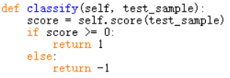
Binary Perceptron 两类感知器 (2)
Assuming two member variables of the class, bias b & weight array w, are properly maintained, write a scoring member function to calculate the score of an input data sample
假设我们恰当地维持着偏向b和权重w数组这两个成员变量，写一个计分的成员函数来计算某个给定输入数据的得分
Write another member function for classification based on the score 再写一个成员函数，基于得分进行分类

Slide 5


Binary Perceptron 两类感知器 (3)
Now we write the member function for training: initialize the weight array based on the data dimension as well as the bias现在我们来写用于训练的成员函数，根据数据的维度来初始化权重数组，并初始化偏向。
Loop for the maximum number of rounds in training, keeping a temporarily variable to record whether weights & bias are updated or not in a round 循环训练的最大轮数，用一个临时变量记录在这一轮是否修改了权重和偏向

Slide 6
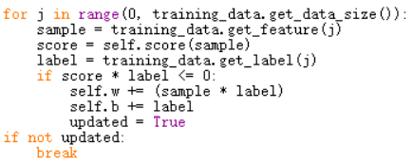
Binary Perceptron 两类感知器 (4)
Training for each data item in a round: update the weights & the bias given an error & stop training if no errors found
在一轮中对每一个数据进行训练，在做错时对权重和偏向进行更新，如果没有错误则终止训练
Error in classification w/ current weights & bias
当前权重和偏向下分类错误

Slide 7
Binary Perceptron 两类感知器 (4)
Training for each data item in a round: update the weights & the bias given an error & stop training if no errors found
在一轮中对每一个数据进行训练，在做错时对权重和偏向进行更新，如果没有错误则终止训练
Stop training if no errors in a round
一轮无错即终止学习

Slide 8

Run It 运行之 (1)
Based on Practice 4.2, in file ‘test.py’, now add a dimension parameter to the function ‘generate_data’ 基于实践4.2，在文件“test.py”中，为函数“generate_data”传入一个维度参数
Use this parameter to determine whether to add the 2nd dimension 根据该参数决定是否加入第二维
Add an optional command line argument for data dimension 为数据维度加入一个可选命令行参数
Retrieve its value after parsing 解析后获取它的值

Slide 9
Run It 运行之 (2)
In training & test data generation (2 places), pass in the dimension value 在训练和测试数据生成时（两处），传入维度值
Now import ‘perceptron’ & create an instance of the ‘BinaryPerceptron’ class for classification 现在，导入“perceptron”，生成“BinaryPerceptron”类型的实例，用于分类
Run w/ the command lines like below
用类似以下的命令行运行
test.py -d 2 40

Slide 10
The End

